Slide 1
Happy Birthday WWW from Python
Python Hack Night 004 @ Hack Portland

Slide 2

Python Hack Night
Welcome to Python Hack Night 0004
Agenda:
  Meet for less than 1 hour for a talk, etc
  Eveything will be posted to our github account
  Have some pizza and hang out for rest of Hack Night
We are sponsored by Hack Portland

Slide 3
Introductions
Tell us:
  Your Name
  What you use Python for
  The first time you used the web?

Slide 4

This Week’s Theme
The Internet is 30 yrs old
It started at CERN in 1989
Time goes so fast...

Slide 5
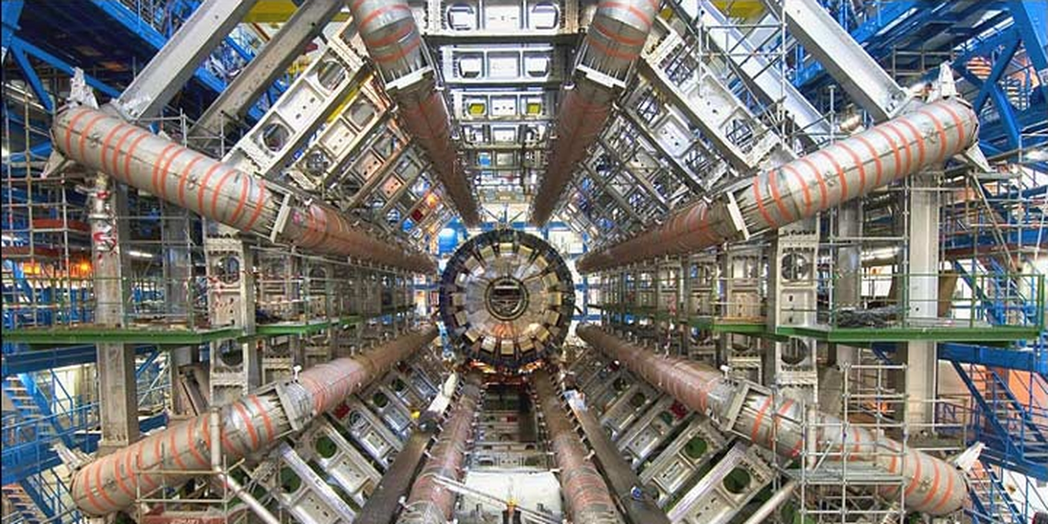

Slide 6
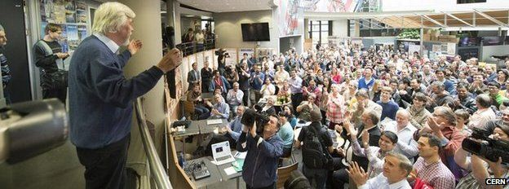

Slide 7
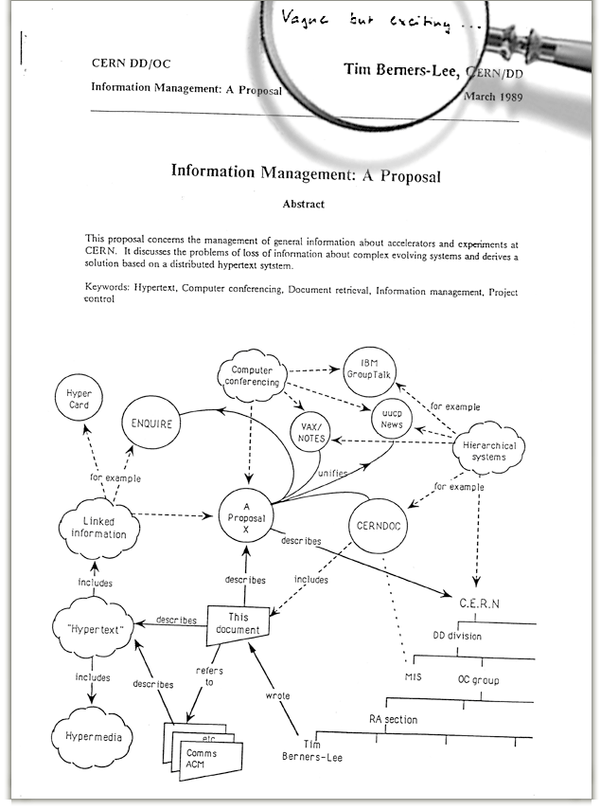

Slide 9
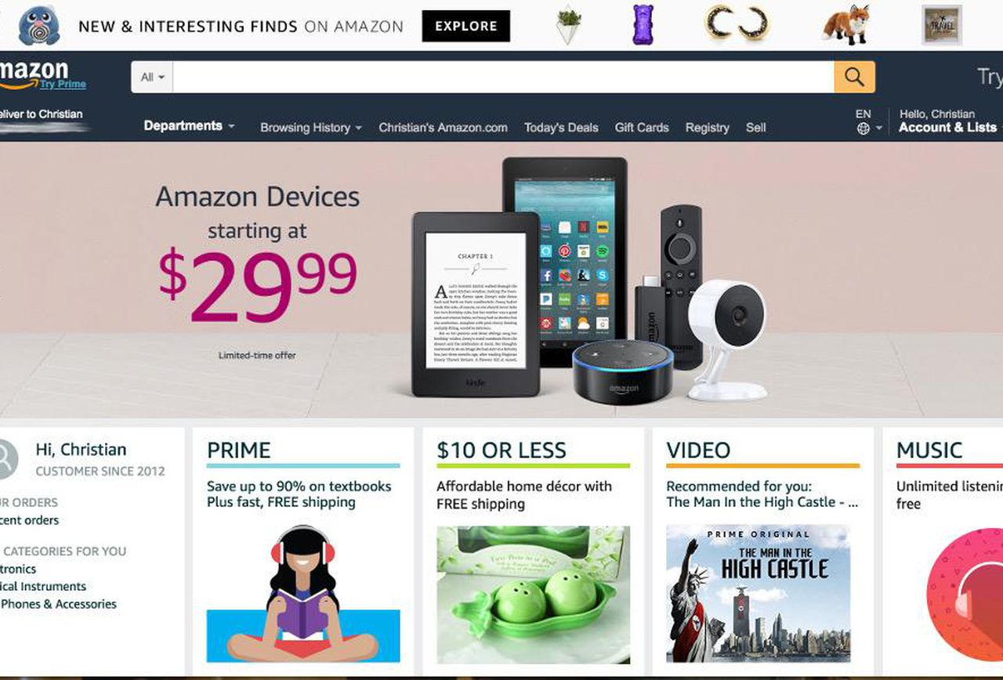
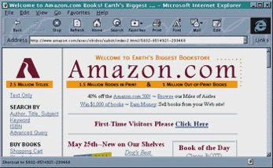
1996
2019

Slide 10
Python and the Web
Many Python tools for ‘The Web’ (Http/CSS/etc):
  Downloading Data
    Requests
    Beautiful Soup
    Easy to role your own
  Hosting Content
    CMS’s (Zope)
    static sites (Jekyll)
    dynamic sites (Django, Flask, Bottle)
  Data Exploration
    Jupyter notebooks

Slide 11
Today’s Demos
Grab some data from the web
  Download stock market information using web scraping
Hosting some data
  Showing a real-time output of a rotary encoder

Slide 12
Scraping Web Data
Want to download data for monitoring/analysis?
  Look for existing modules (Python is BOP)
  If you have to role your own:
    Use Requests
    Use modules like Beautiful Soup for complex web pages
    Parse text directly if the page is simple
    Many pages use Javascript → use Selenium or OCR

Slide 13
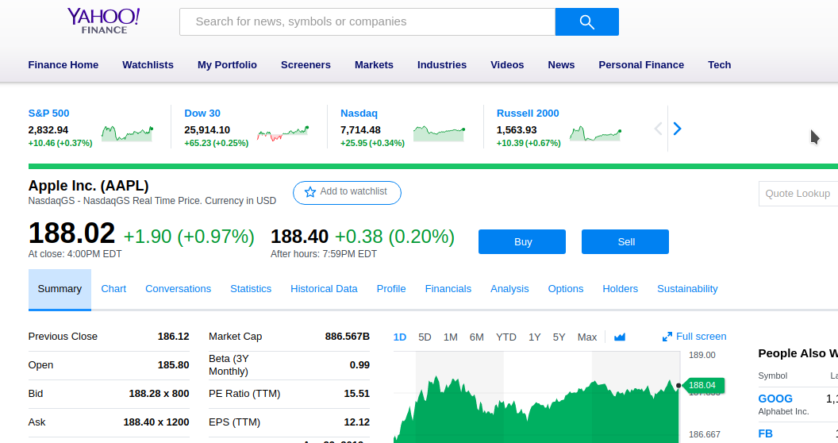
Downloading Stock Data
Use Yahoo Finance as a data source (BOP)

Slide 14
Downloading Stock Data
Review ‘driver_yahoo.py’
  Implemented data connection as a driver
    Can develop different drivers if needed
  Built Yahoo driver after some experimentation
    Grab web page with stock quote URL using requests
    Wrote a hand parser to look for stock data
      This was difficult, took a while (need good diagnostics)
    Demos
    I would use yahoofinancials for a more complete implementation:
      https://github.com/JECSand/yahoofinancials

Slide 15
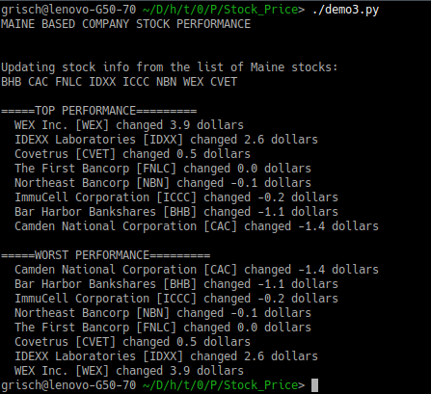

Slide 16
Hosting a Web App
Typically need for a remote machine/equipment
  Telemetry (aka ‘IoT’)
  Need to share with colleagues
    US, around the world
  Need an easy interface
  Need some iterative features like gauges, graphs, etc

Slide 17
Hosting a Web App
Arduino for machine data (encoder_reader.ino)
Python driver for encoder data (encoder.py)
Web app is written with Bottle (server.py)
  Bottle is a one-page framework
  Included some fancy Javascript to display a gauge
Demo

Slide 18
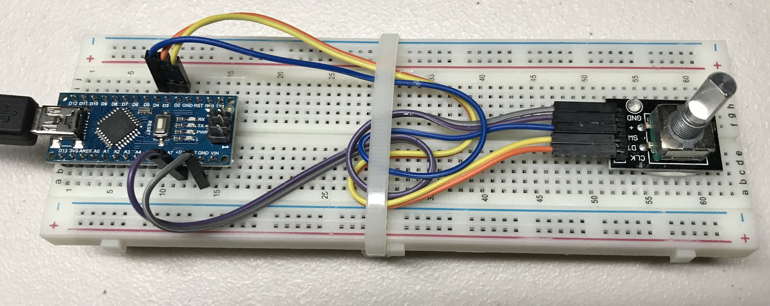
Rotary Encoder
Arduino Nano

Slide 19
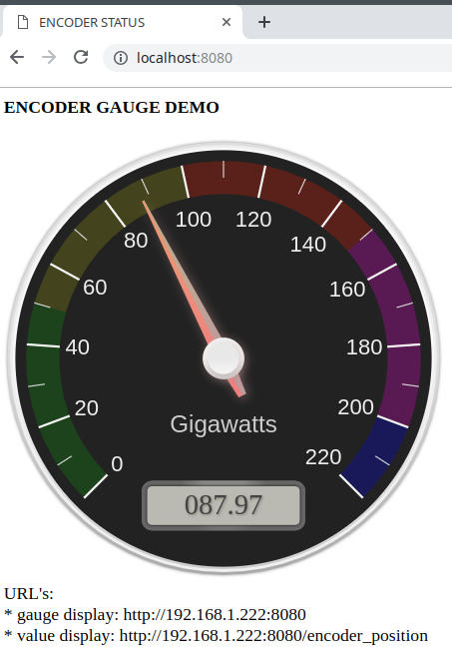

Slide 20
Summary
In 30 years, WWW has come a long way
  Static pages → Ajaxy goodness → web sockets → ???
  Will it be needed in 30 more years (apps?)
Get out there and see what you can make with Python!

Slide 21
Questions?

Slide 22
Have an Idea for a Talk?
Come see me...

Slide 23
FOR MORE INFORMATION:
GitHub for Hack Portland will have all the files (need to set up)
Python Modules:
Requests - 'HTTP for humans', a Python module to support HTTP (http://docs.python-requests.org/en/master/)
Bottle - a single file micro-framework for Python (https://bottlepy.org/docs/dev/)
ifaddr - find the IP addresses of network interfaces (https://github.com/pydron/ifaddr)
PySerial - serial support (>pip3 install pyserial)
HTML/JAVSCRIPT
Canvas Gauges - animated gauges (https://canvas-gauges.com)
Arduino:
Arduino Nano - used to implement rotary encoder (ALPS STEC12E07)
CmdArduino - Command line serial library for Arduino (https://github.com/fakufaku/CmdArduino)
Encoder - encoder library for interupt driven quadrature encoders (https://github.com/PaulStoffregen/Encoder)
Button - library to make handling of button very simple (https://github.com/madleech/Button)
JLED - Non-blockig LED effects like blinking and breathing LED's

